Slide 1

Sagar Saha
142014024
Department of CSE
Internship
CSE 499
Supervised By:
Satyaki Das
Lecturer | Dept. of CSE
University Of Liberal Arts Bangladesh

Slide 2
About The Organization
I started as a full –stack Internship at Banglasoft computer at 23th February 2020 and working there as a web based application developer .
Banglasoft computer is a software development company which is incorporated in 2008 and has been successfully delivering various digital services and made a huge impact in the digital market with app and web based streaming services.
Services:
Application development
Web application development
Value added service
E-commerce app development

Slide 3
Objectives
To know the historical background of the industry including its mission, vision , objectives and strategies
To get the real-life exposure in the web development sector
To know how the problems are solved by them
To know the coding conventions and style of the web development sector

Slide 4
Project Requirements
Creating A web-based Ecommerce application
Make it responsive
Preferable language using –
HTML
PHP
Bootstrap
Jquery
React , Node js.

Slide 5
Project & Tools
Develop an react based Ecommerce application.
This Ecommerce System is an web based application for selling product, manage customers, and calculate company revenue.
Tools
Visual Studio Code
Local Server – Xampp

Slide 6
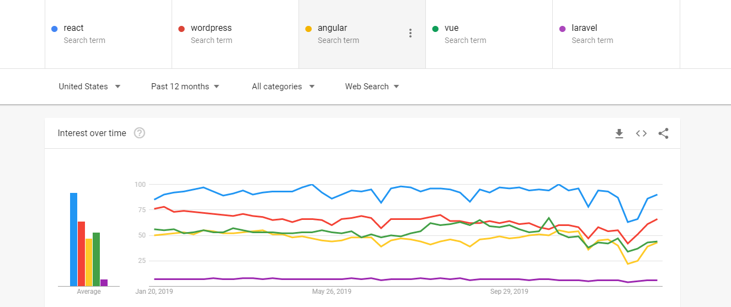
Why React JS
React is an open-source JavaScript library. With react a web application can be built which don’t need any reload for changing the data of the page which make the application become more faster & scalable & it also makes the application user friendly.
While researching I had compared React JS, Laravel, Angular JS, Vue JS and WordPress which is a CMS in Google Trends. In the result I had found that in USA most developers use React JS, in India most developers use WordPress and in Bangladesh almost 80% developers use Laravel for web development. The results found in Google Trends are given below:

Slide 7
Project Features
User registration
Login & logout.
Filter by categories.
Add product to cart.
Checkout
Manage product.

Slide 8
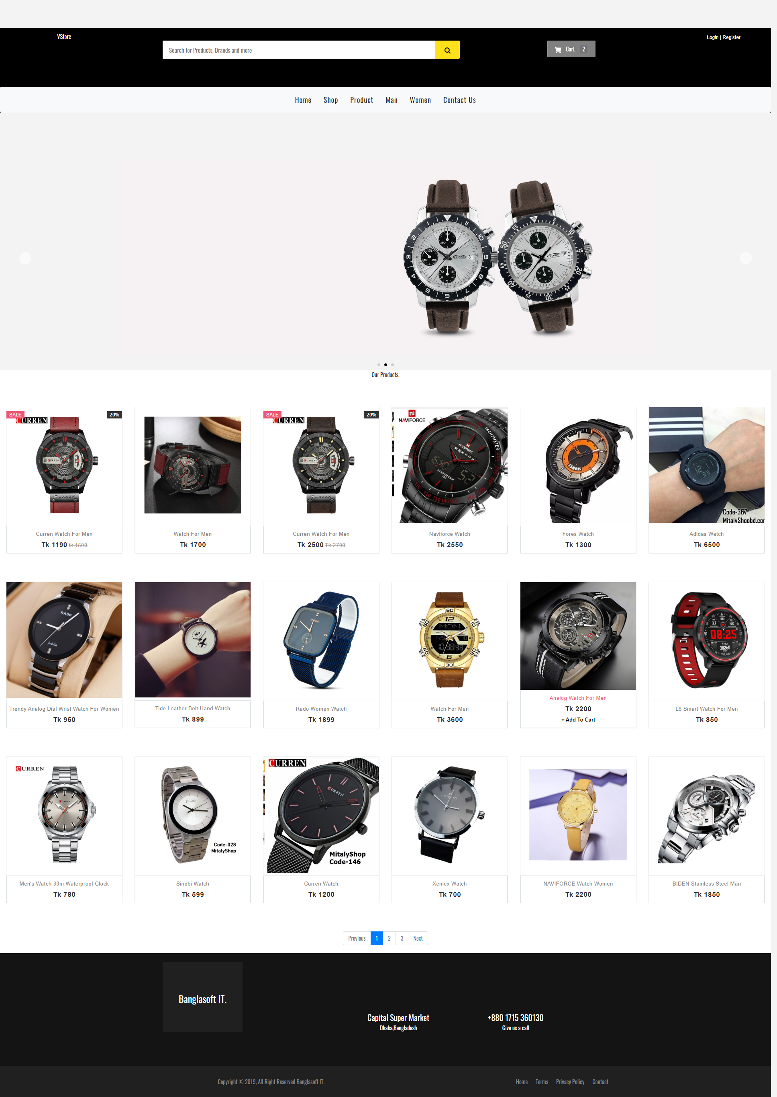
Front Page

Slide 9
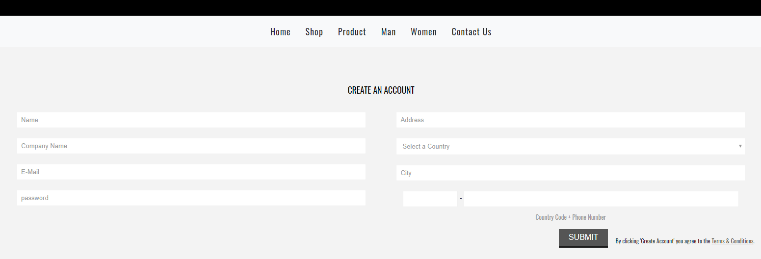
User Registration

Slide 10
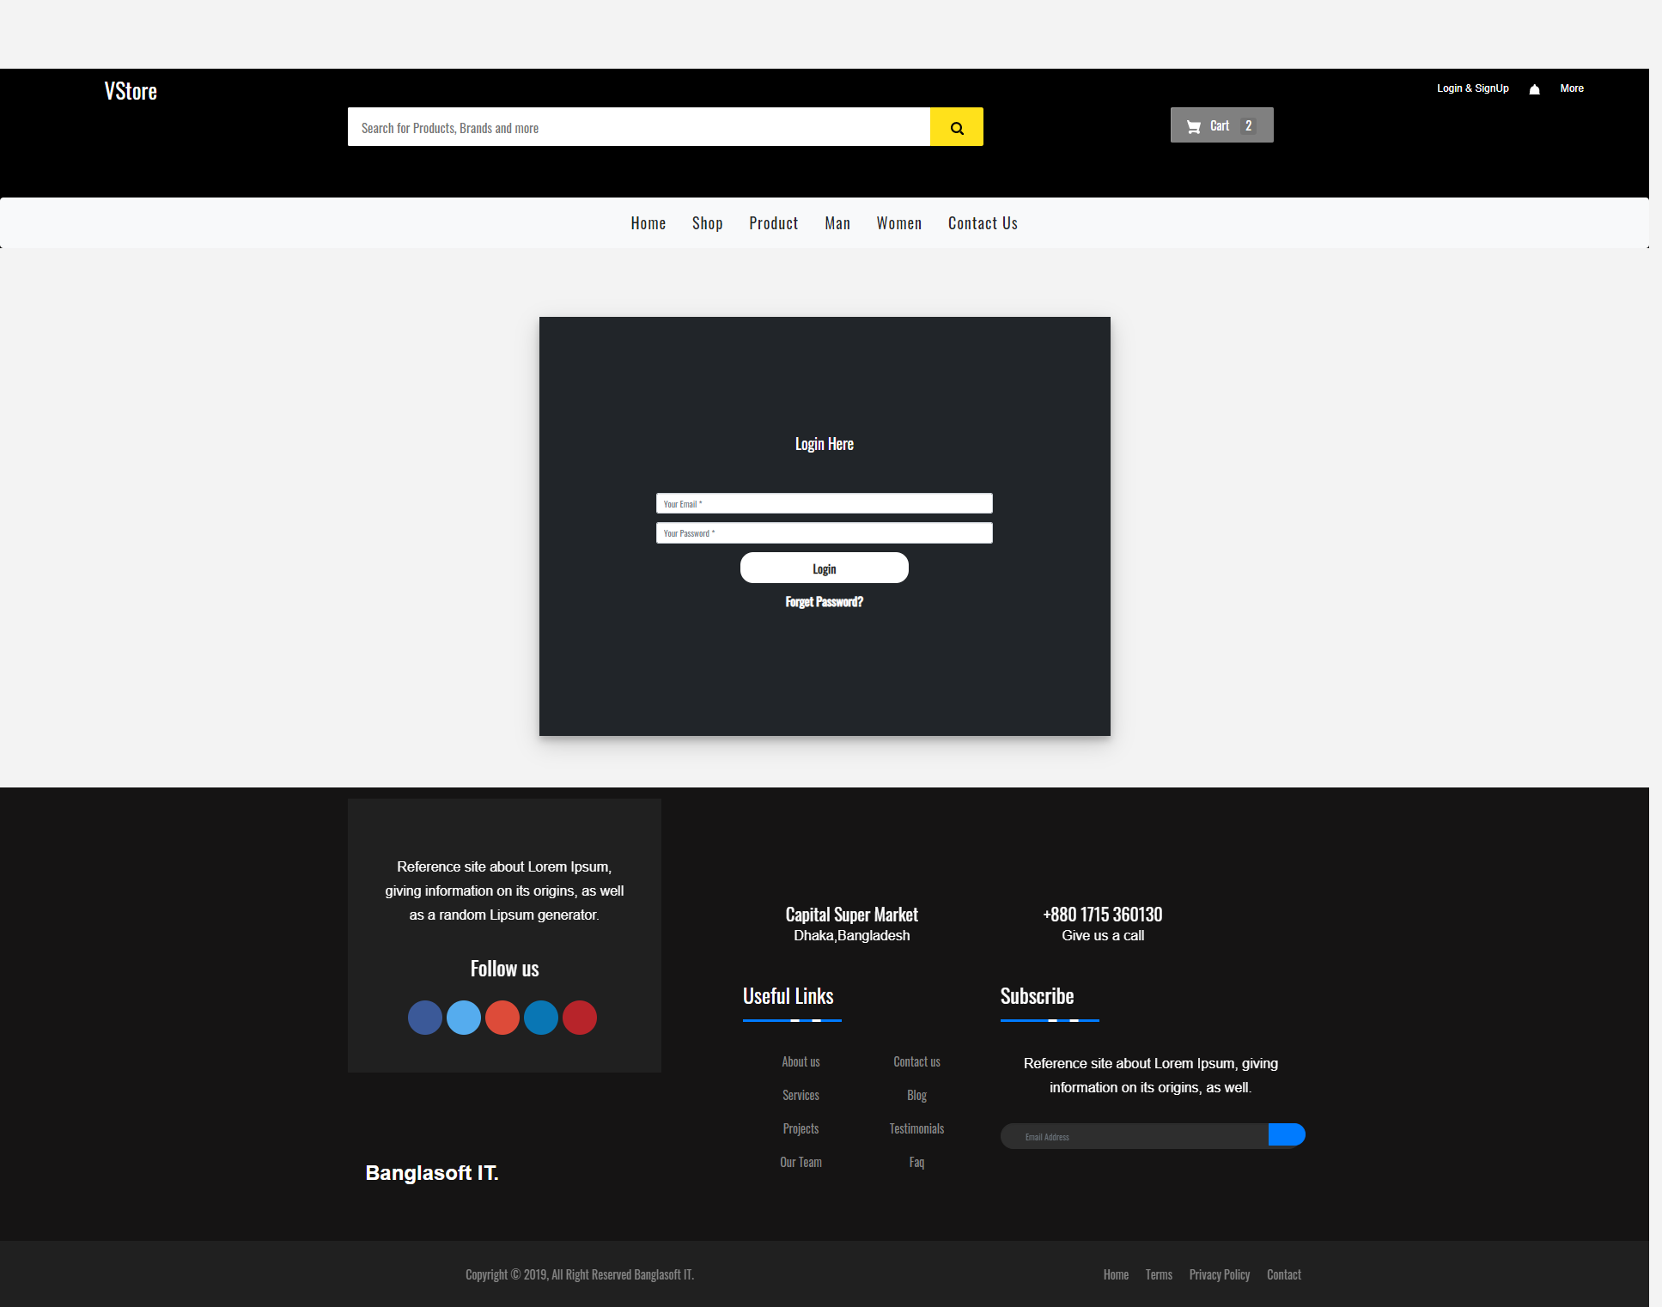
User Login

Slide 11
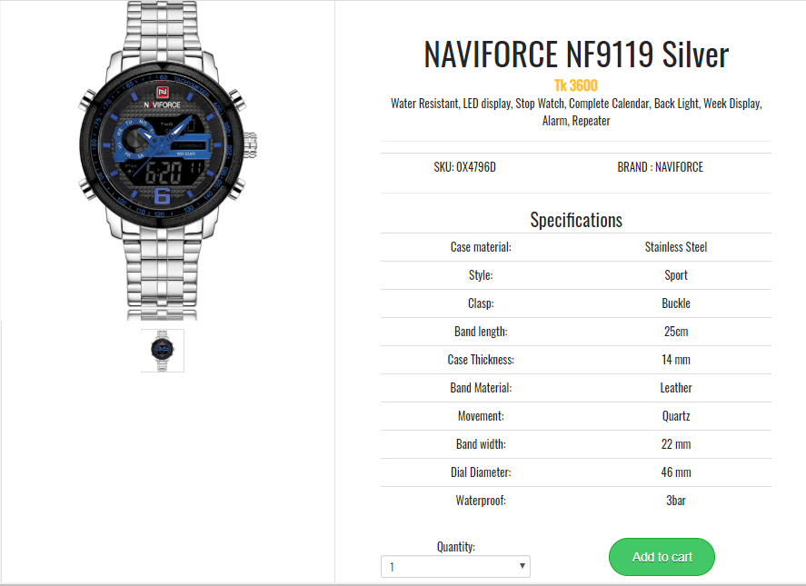
Product Details Page

Slide 12
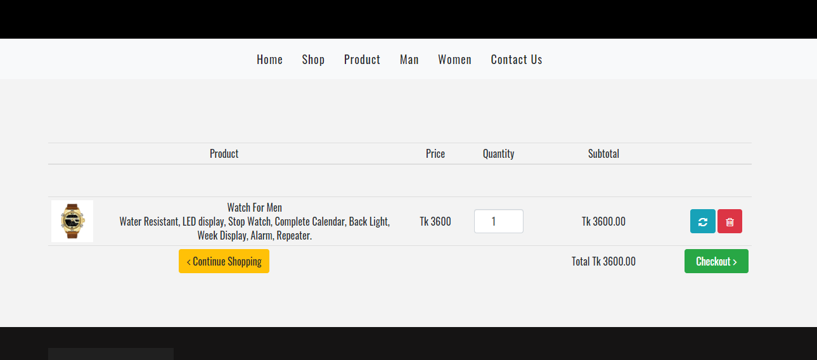
Product Cart

Slide 13
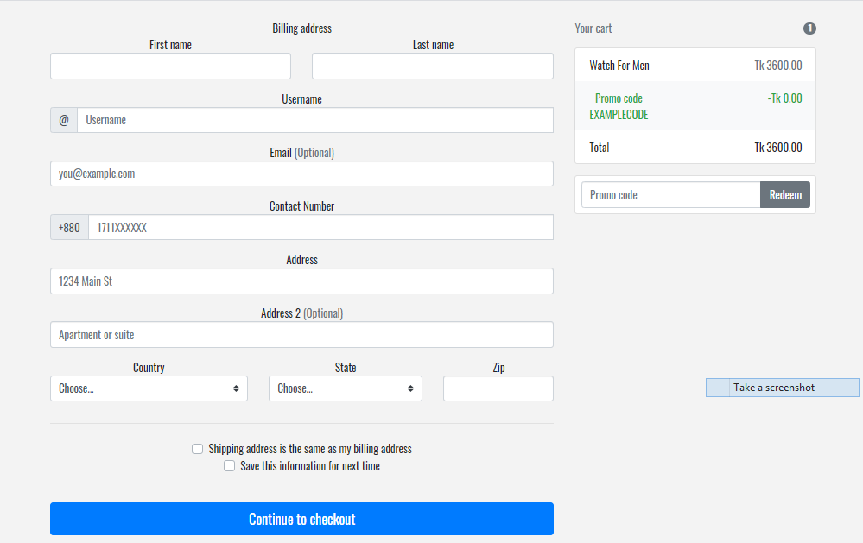
Checkout

Slide 14


Problems:
Zero experience from the past.
Less time to train up.
Some unknown topics.
Advantages:
Improve skill, ability of working and solving problems.
Learn a lot of new things.
Gather experience.
Become ready for the future.
Carrier Opportunity

Slide 15


